Slide 1
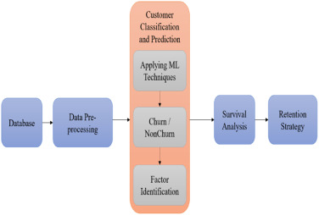
Customer Churn Analysis in the Telecom Industry
Objective: Predict customer churn and develop strategies to retain customers in a highly competitive telecom environment.
Business Impact: Understanding churn patterns and creating targeted interventions can help reduce customer attrition, improve retention, and boost revenue.

Slide 2
Approach:
SQL for feature aggregation
PostgreSQL connection
Python for machine learning
ELI5 for explainability
Segmentation & Recommendations

Slide 3
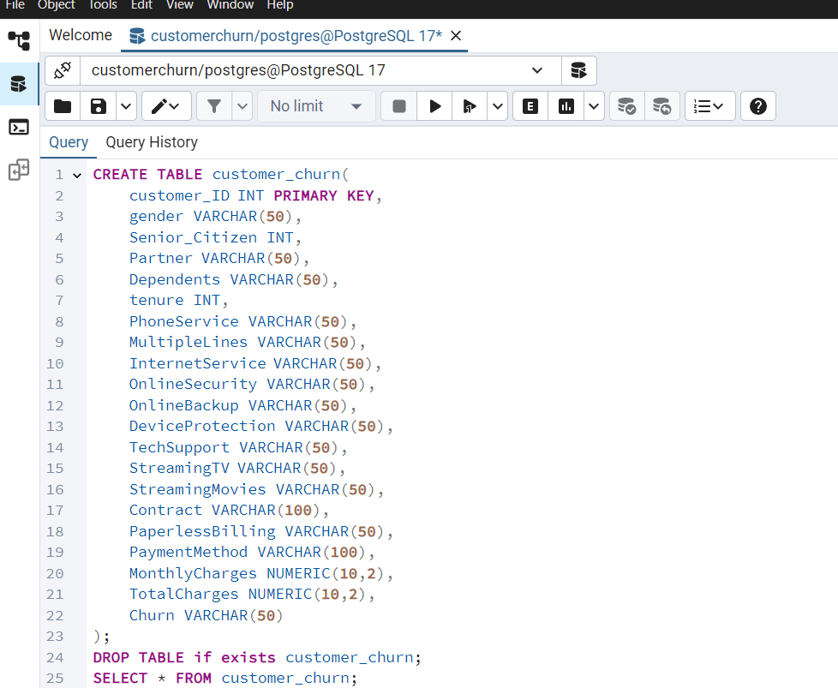
Data Extraction with SQL
Database: PostgreSQL
Queries Performed:
Aggregated call durations (monthly/
weekly)
Count of service complaints
Recharge frequency per customer
Tools Used: SQLAlchemy
Purpose: Fetch query output
directly into Python

Slide 4
Data Preprocessing in Python
Libraries: Pandas, Numpy
Steps:
Data cleaning (nulls, outliers)
Feature encoding
Train-test split
ML Model Development
Model Type: Binary classification (e.g., Logistic Regression, Random Forest)
Library: Scikit-learn
Target: Churn (Yes/No)
Performance Metrics: Accuracy, Precision, Recall, F1 Score

Slide 5
Customer Segmentation
Method: Based on churn probability + usage patterns
Segments:
At Risk (high churn probability)
Loyal (low churn probability, high usage)
Dormant (low engagement, medium risk)

Slide 6
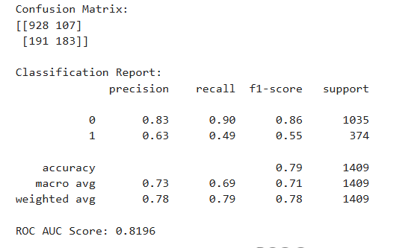
Conclusion- Accuracy-79%

